Slide 1
INFO 371: Data Mining Applications
College of Computing and Informatics
Drexel University
Introduction and Course Overview
Yuan An, PhD
Associate Professor
Notes:
Aristotle example – Clustering
Classification vs Clustering
Break down animals into two different groups vs clustering existing animals and putting them together based on the features they have

Slide 2
Agenda
Course overview
Course work
Introduction to Data Mining and Machine Learning
Terminology
Python and Jupyter notebook
Google colab

Slide 3
Course Introduction
Data Mining and Machine Learning
Introduces students to basic data mining approaches using machine learning tools. Focuses on machine learning algorithms for information inference and knowledge discovery from data. Covers major applications in data/text/web processing, analysis and mining.

Slide 4
Course Outcome
Upon successful completion of this course, a student will be able to:
Describe major machine learning approaches to data processing and mining
Apply machine learning theories and concepts in finding data mining solutions.
Design automated systems to infer information and discover knowledge from data.
Evaluate data mining processes and technologies in domain applications.
Use or integrate machine learning tools to support data (pre-)processing, mining, and analysis.

Slide 5
Topics
Data preparation for data mining and machine learning
Data formats and types
Supervised and unsupervised machine learning methods
KNN for classification
Association rule mining and market basket analysis
Probabilistic methods, Naïve Bayes classification
Text mining and TF/IDF representation
Decision tree
Clustering and KMeans
Evaluation metrics - accuracy, precision, recall, ROC, AUC
Model selection and Bias-Variance trade-off

Slide 6
Textbook and Reference
Recommended Textbooks
Robert Layton. Learning Data Mining with Python. Packt, 2017. (Available through Drexel Library)
Additional References
Wes McKinney. Python for Data Analysis. O’Reilly, 2017. (Available through Drexel Library)
Ian H. Witten, Eibe Frank, and Mark A. Hall. Data Mining: Practical Machine Learning Tools and Techniques (Third or Fourth Edition). Morgan Kaufmann.
Kevin P. Murphy. Machine Learning A Probabilistic Perspective. MIT Press. 2012

Slide 7
Software and Tools
Python packages: Numpy, Scipy, Pandas, Matplotlib, and Scikit-Learn
Jupyter notebook
Markdown for documentation
Google Colab:
Online Jupyter notebook environment
Zero configuration

Slide 8
Prerequisite
College level mathematics
STAT 201 basic knowledge about probability and statistics
Basic programming concepts and skills:
Will learn and use Python throughout the course
Most of the time, write simple statement to use built-in functions defined in Python data processing and machine learning packages.

Slide 9
Course Work
Task | Weight | Due
Assignment 1 | 15% | Week 2
Assignment 2 | 15% | Week 4
Midterm Exam | 20% | Week 5
Assignment 3 | 15% | Week 6
Assignment 4 | 15% | Week 8
Team project | 20% | End of the term

Slide 10
Course Work
4 individual assignment on data mining and machine learning methods
One midterm exam
One final course project

Slide 11
Course Project
Team work
Team can have up to 3 students
Build predictive machine learning models

Slide 12
Course Syllabus Review
Review the course syllabus

Slide 13
Introduction to Data Mining and Machine Learning

Slide 14
From data to information
Society produces huge amounts of data
Sources: business, science, medicine, economics, geography, environment, sports, …
This data is a potentially valuable resource
Raw data is useless: need techniques to automatically extract information from it
Data: recorded facts
Information: patterns underlying the data
We are concerned with machine learning techniques for automatically finding patterns in data
Patterns that are found may be represented as structural descriptions or as black-box models

Slide 15
Machine Learning
Computer Science
Mathematics
Neuroscience
Machine Learning
Statistics
Psychology
Economics
Linguistics

Slide 16
What is machine learning?
Machine Learning is the science (and art) of programming computers so they can learn from data
More general definition (Arthur Samuel, 1959):
Machine Learning is the field of study that gives computers the ability to learn without being explicitly programmed.
More engineering-oriented definition (Tom Mitchell, 1997):
Machine Learning is the study of algorithms that
Improve their performance P
At some task T
With experience E
A well-defined learning task is given by <P, T, E>
Examples: classify emails as spam or not
Notes:
"A computer program is said to learn from experience E with respect to some class of tasks T and performance measure P, if its performance at tasks in T, as measured by P, improves with experience E"

Slide 17
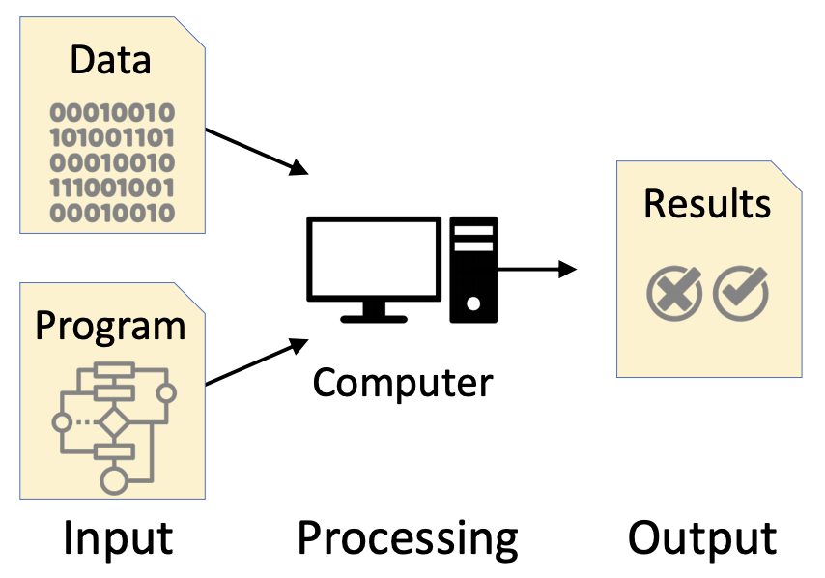
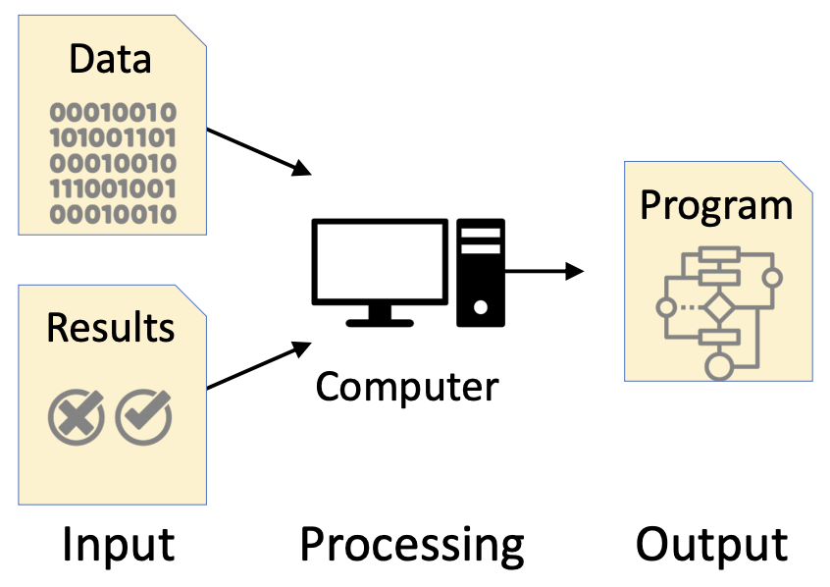
Traditional Programming
Machine Learning
Works well when we know how to specify the program
Needed when we do not know how to specify the program

Slide 18
When we need Machine Learning?
Tasks are challenging to specify our knowledge
Facial recognition
Medical diagnosis
Tasks involving big data
Anomaly detection
Genomics
Tasks requiring customization
Personalized medicine
Email filtering
…

Slide 19
Machine Learning Process
Notes:
Extract – Clean and mine – Transform to tables or something – pattern discovery - visualization

Slide 20
Examples

Slide 21
Classification Problem 1
Examples of class A
Examples of class B
3 4
5 2.5
1.5 5
5 2
6 8
8 3
2.5 5
4.5 3

Slide 22


Classification Problem – supervised ML
What class is this object?
Examples of class A
Examples of class B
3 4
5 2.5
8 1.5
What about this one, A or B?
1.5 5
5 2
6 8
8 3
4.5 7
2.5 5
4.5 3

Slide 23

10
Geometric Interpretation
9
8
Examples of class A
Examples of class B
7
6
Left Bar
5
4
3
2
3 4
5 2.5
1
1
2
3
4
5
6
7
8
9
10
Right Bar
1.5 5
5 2
Here is the rule:
If the left bar is smaller than the right bar, it is an A, otherwise it is a B.
6 8
8 3
2.5 5
4.5 3

Slide 24

10
Another Example and Interpretation
9
8
Examples of class A
Examples of class B
7
6
Left Bar
5
4
3
2
4 4
10 4
1
1
2
3
4
5
6
7
8
9
10
Right Bar
1 5
9 5
6 3
6 8
The rule:
if the square of the sum of the two bars is less than or equal to 100, it is an A. Otherwise it is a B.
3 7
7 7

Slide 25
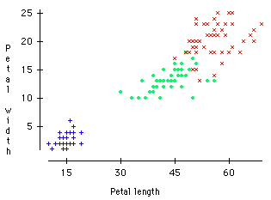
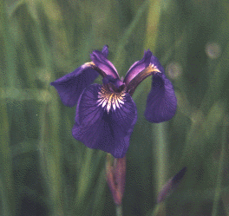

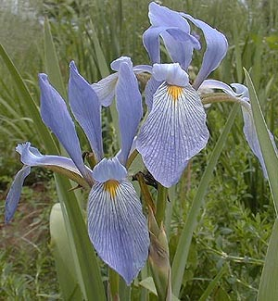
Virginica
A Famous Problem
R. A. Fisher’s Iris Dataset.
3 classes
50 of each class
The task is to classify Iris plants into one of 3 varieties using the Petal Length and Petal Width.
Setosa
Versicolor
Iris Setosa
Iris Versicolor
Iris Virginica

Slide 26
Terminology

Slide 27
Terminology
Concept
What to be learned in the data
Output of the learning is concept description
Types of learning
Classification
Association
Clustering
Numeric prediction
Notes:
Association – Purpose is to discover the association between items.

Slide 28

What’s a concept?
Concept: thing to be learned
Concept description: output of learning scheme
Styles of learning:
Classification learning: predicting a discrete class
Association learning: detecting associations between features
Clustering: grouping similar instances into clusters
Numeric prediction/regression: predicting a numeric quantity
Notes:
Identificaiton of type of ML model

Slide 29
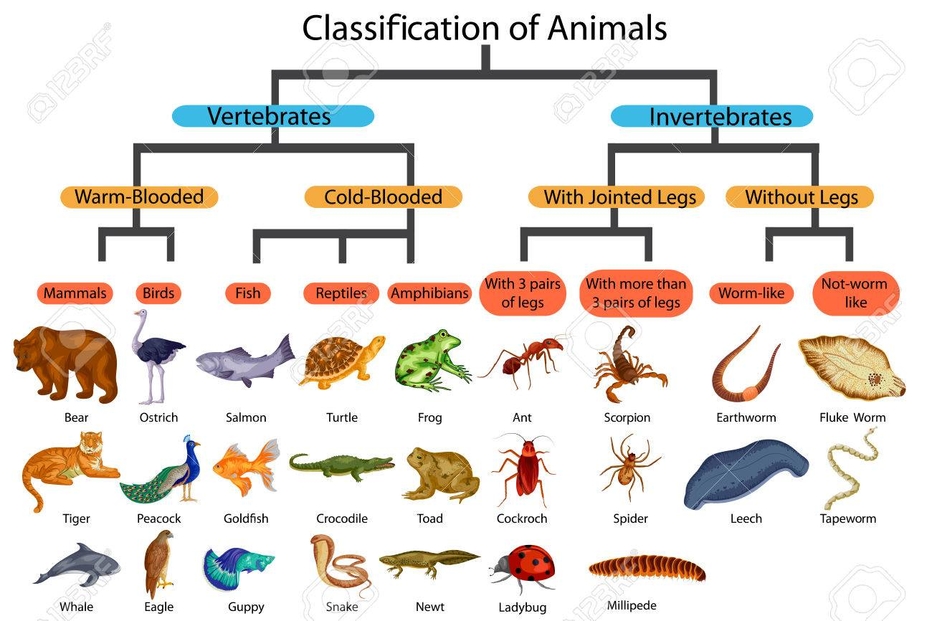
Classification learning
Example problems: weather data, contact lenses, irises, labor negotiations
Classification learning is supervised
Scheme is provided with actual outcome
Outcome is called the class of the example
Measure success on fresh data for which class labels are known (test data)
In practice success is often measured subjectively

Slide 30
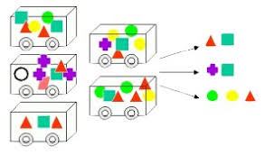
Association learning
Can be applied if no class is specified and any kind of structure is considered “interesting”
Difference to classification learning:
Can predict any attribute’s value, not just the class, and more than one attribute’s value at a time
Hence: far more association rules than classification rules
Thus: constraints are necessary, such as minimum coverage and minimum accuracy

Slide 31
Clustering
Finding groups of items that are similar
Clustering is unsupervised
The class of an example is not known
Success often measured subjectively
Sepal length
Sepal width
Petal length
Petal width
Type
1
5.1
3.5
1.4
0.2
Iris setosa
2
4.9
3.0
1.4
0.2
Iris setosa
…
51
7.0
3.2
4.7
1.4
Iris versicolor
52
6.4
3.2
4.5
1.5
Iris versicolor
…
101
6.3
3.3
6.0
2.5
Iris virginica
102
5.8
2.7
5.1
1.9
Iris virginica
…

Slide 32
Numeric prediction
Variant of classification learning where “class” is numeric (also called “regression”)
Learning is supervised
Scheme is being provided with target value
Measure success on test data
Outlook
Temperature
Humidity
Windy
Play-time
Sunny
Hot
High
False
5
Sunny
Hot
High
True
0
Overcast
Hot
High
False
55
Rainy
Mild
Normal
False
40
…
…
…
…
…

Slide 33
Points to take away
The concepts of learning:
Classification
Association rules
Clustering
regression
Types of Learning:
Supervised
Unsupervised
Semi-supervised
Distant-supervised
…

Slide 34
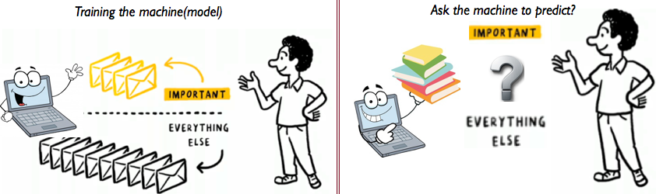
What’s in an example?
Instance: specific type of example
Thing to be classified, associated, or clustered
Individual, independent example of target concept
Characterized by a predetermined set of attributes
Input to learning scheme: set of instances/dataset
Represented as a single relation/flat file
Rather restricted form of input
No relationships between objects
Most common form in practical data mining

Slide 35
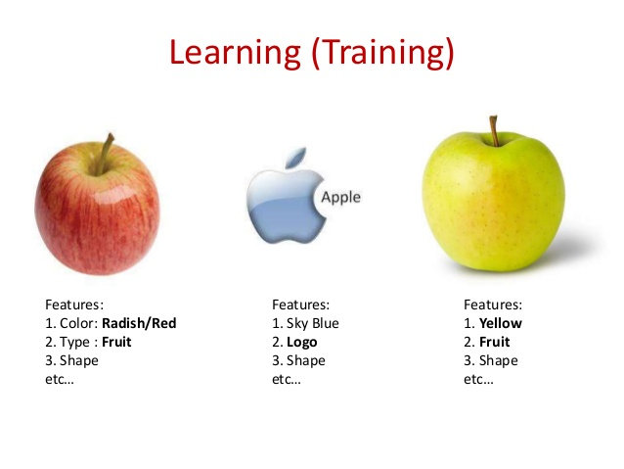
What’s in an attribute?
Each instance is described by a fixed predefined set of features, its “attributes”
But: number of attributes may vary in practice
Possible solution: “irrelevant value” flag
Related problem: existence of an attribute may depend of value of another one
Possible attribute types (“levels of measurement”):
Nominal, ordinal, interval and ratio

Slide 36
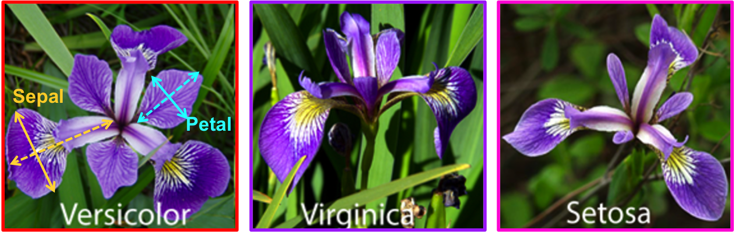
Feature/Attribute

Slide 37
Nominal levels of measurement
Values are distinct symbols
Values themselves serve only as labels or names
Nominal comes from the Latin word for name
Example: attribute “outlook” from weather data
Values: “sunny”,”overcast”, and “rainy”
No relation is implied among nominal values (no ordering or distance measure)
Only equality tests can be performed

Slide 38
Ordinal levels of measurement
Impose order on values
But: no distance between values defined
Example: attribute “temperature” in weather data
Values: “hot” > “mild” > “cool”
Note: addition and subtraction don’t make sense
Example rule: temperature < hot ⇒ play = yes
Distinction between nominal and ordinal not always clear (e.g., attribute “outlook”)

Slide 39
Interval quantities
Interval quantities are not only ordered but measured in fixed and equal units
Example 1: attribute “temperature” expressed in degrees Fahrenheit
Example 2: attribute “year”
Difference of two values makes sense
Sum or product doesn’t make sense
Zero point is not defined!

Slide 40
Ratio quantities
Ratio quantities are ones for which the measurement scheme defines a zero point
Example: attribute “distance”
Distance between an object and itself is zero
Ratio quantities are treated as real numbers
All mathematical operations are allowed
But: is there an “inherently” defined zero point?
Answer depends on scientific knowledge (e.g., Fahrenheit knew no lower limit to temperature)

Slide 41
Attribute types used in practice
Many data mining schemes accommodate just two levels of measurement: nominal and ordinal
Others deal exclusively with ratio quantities
Nominal attributes are also called “categorical”, ”enumerated”, or “discrete”
But: “enumerated” and “discrete” imply order
Special case: dichotomy (“boolean” attribute)
Ordinal attributes are sometimes coded as “numeric” or “continuous”
But: “continuous” implies mathematical continuity

Slide 42
Points to take away
Types of features/attributes
Nominal/categorical
“good”, “bad”, “hot”, ”mild”, “false”, “true”….
Ordinal
”small”, “medium”, “large”
Numeric
Real values
Interval:
1990, 1991, …

Slide 43
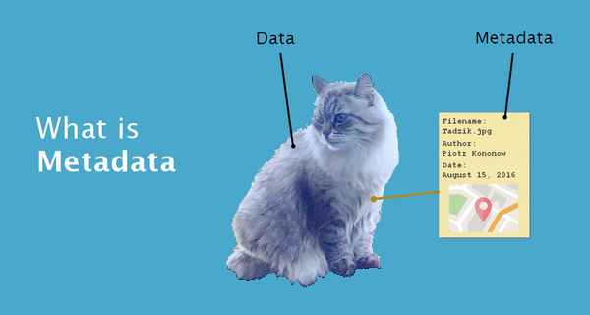
Metadata
Information about the data that encodes background knowledge
In theory this information can be used to restrict the search space of the learning algorithm
Examples:
Dimensional considerations (i.e., expressions must be dimensionally correct)
Circular orderings (e.g., degrees in compass)
Partial orderings (e.g., generalization/specialization relations)

Slide 44
Data Format
Notes:
ML – Continuous Numers – Regression.

Slide 45
Multi-dimensional data
Tabular format: spreadsheet, table, DataFrame
Rows are instances
Columns are features
Commonly stored as CSV (comma separated values) in disk

Slide 46
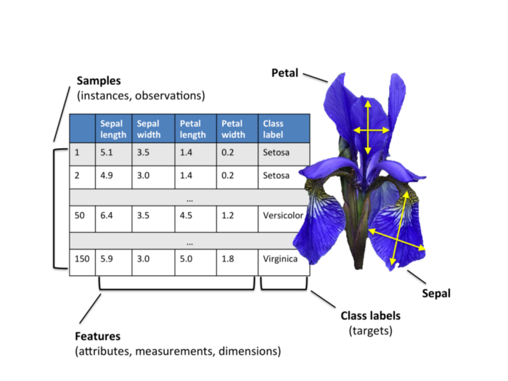

Slide 47
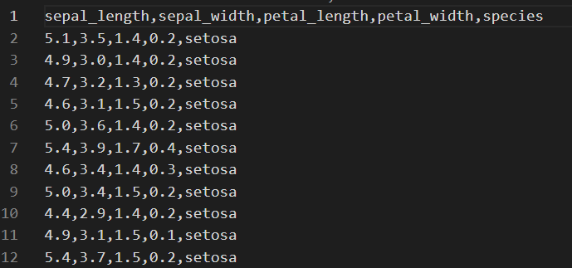
CSV

Slide 48
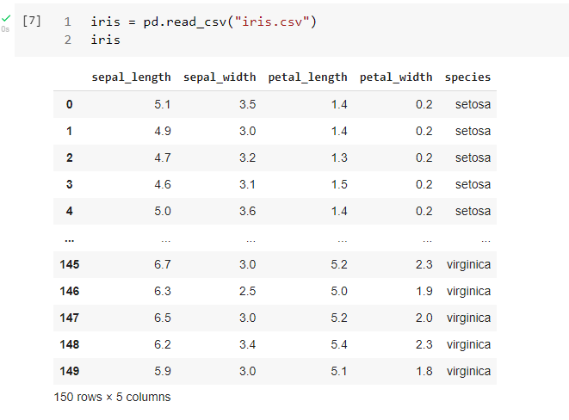
DataFrame

Slide 49
Python and Jupyter Notebook

Slide 50
Python for Data Mining
A popular language and environment for data mining and machine learning
Human friendly syntax and interfaces
Industry standard
Rich library for solving various data mining problems
Interactive computing

Slide 51
Jupyter Notebook
Web browser-based open source platform for interactive computing, combining
Programing code
Documentation
Output
Visualization
Multimedia
Latex for math
HTML markup

Slide 52
Google Colaboratory (colab)
Free online Jupyter notebook
https://colab.research.google.com/notebooks/intro.ipynb
Easily connect to your google drive
Better with a gmail account
Demo…

Slide 53
Jupypter Notebook for Assignments
All assignments using Jupyter notebooks
2 types of cells:
Markdown cell for documentation
Code cell for running programs

Slide 54
Jupyter Notebook Keyboard Shortcuts
Colab has nice user interfaces for interacting with notebooks.
If you work on your own environment:
Shift-Enter: run the code cell and move to the next cell
Ctrl-Enter: run the code cell and stay in the cell
Esc-A: add a cell above
Esc-B: add a cell below
Esc-M: switch to markdown cell
Esc-Y: switch to code cell

Slide 55
Markdown Syntax
Element | Markdown Syntax
Heading | # H1 ## H2 ### H3
Bold | **bold text**
Italic | *italicized text*
Blockquote | > blockquote
Ordered List | 1. First item 2. Second item 3. Third item
Unordered List | - First item - Second item - Third item
Code | `code`
Horizontal Rule | ---
Link | [title](https://www.example.com)
Image | ![alt text](image.jpg)

Slide 56
Markdown Syntax
Element | Markdown Syntax
Table | | Syntax | Description | | ----------- | ----------- | | Header | Title | | Paragraph | Text |
Fenced Code Block | ``` { "firstName": "John", "lastName": "Smith", "age": 25 } ```
Footnote | Here's a sentence with a footnote. [^1] [^1]: This is the footnote.
Heading ID | ### My Great Heading {#custom-id}
Definition List | term : definition
Strikethrough | ~~The world is flat.~~
Task List | - [x] Write the press release - [ ] Update the website - [ ] Contact the media

Slide 57
Import Python Packages
By convention, each notebook will import the following packages at the beginning:
import pandas as pd
import numpy as np
import scipy as sp
import matplotlib.pyplot as plt
%matplotlib inline: let visualization results show up on the notebook page

Slide 58
Example on JN
Run JN examples

